Slide 1

NAME: DAVID WACHIRA GITONGA
REG NO: SCCI/00277/2015
COURSE: BACHELOR OF TECHNOLOGY (COMPUTER TECHNOLOGY)
PROJECT TITLE: SHOP INVENTORY MIS

Slide 2
INTRODUCTION
A business is an organization or economic system where goods and services are exchanged for one another or money.
According to Internal Revenue service (IRS), keeping good records is very important for businesses.
It helps them; monitor the progress of their business, prepare financial statements, identify their sources of income.
Record keeping for small-scale retailers/ fixed shop retailers.
Record keeping facilitates stock tracking and monitoring of business finances.
Notes:
Importance of keeping records

Slide 3
PROBLEM STATEMENT
It would be ideal for small-scale shop keepers/owners to have proper records which will facilitate monitoring of business progress and financial reporting.
Currently, keeping track of business progress is a difficult manual task which some small-scale shop owners even ignore.
Disadvantages: -
Losses
Inability to track stock
Unnecessary Loans
Inability to study the market
The proposed system will be very effective in managing the business operations and hence meeting the above disadvantages for small-scale retailers.
Notes:
= Difficulty in keeping track of business progress
Manual process of record keeping
Books of account (journals and ledgers)
Exercise books
Makes data analysis difficult.

Slide 4
OBJECTIVES
Major Objective
The main goal of this project is to ease the work of data recording and analysis for owners of small businesses.
General Objective
To develop a web application that automates data recording and analysis for the owners of small businesses.

Slide 5
SPECIFIC OBJECTIVES
To provide users with an interface through which they can stock their shops (they can either add new items or update the quantities of already existing items).
To provide users with an interface for recording sales.
To design an interface through which users can track their stock. They will be able to tell how much stock they have left at any point of time.
To create an interface that allows user to view, download and print profit and loss statements.
To send users SMS alerts when they are almost out of stock.
Notes:
Stock shop
Record sales
Track Stock = tell what is in stock at every time
Profit and loss statements/ income statements.
SMS alerts

Slide 6
LITERATURE REVIEW
SMALL-SCALE RETAILERS
They are also called fixed shop retailers.
These are retailers who run small shops that deal with miscellaneous products of daily use and shops that sell particular products of various varieties.
Examples: -
Single Shops
Tied shops
Market stalls
Kiosks
Canteens

Slide 7
LITERATURE REVIEW cont………
EXISTING SYSTEMS
Odoo
ODOO, formerly known as OpenERP (Enterprise Resource Planning), is a platform that companies can use to easily manage the basics of the company such as materials and warehouse management, human resources, finance, accounting, sales and many other enterprise features. This is being done by means of an intuitive user interface that can be easily extended with community modules or with customized modules that suit the client's purposes. Helping you make smart decisions every day, ODOO can be used by companies of all sizes, offering a clear and integrated view of your business
Notes:
Companies can create accounts.
Warehouse mgt
HR mgt
Financial Accounting
POS

Slide 8
METHODOLOGY
METHODS OF DATA COLLECTION
The Questionnaire Survey
A questionnaire is a research instrument consisting of a series of questions for the purpose of gathering information from respondents.
For this study, a questionnaire with both closed and open-ended questions was designed to call for response.
The questionnaires was designed to gather information about how shop keepers and business owners record their income and expenses, whether/how they report on the data and whether/ how the analyzed data helps the business.
The Interview Survey
A personal interview survey is a survey method that is utilized when a specific target population is involved. The purpose of conducting this survey is to explore the responses of the people to gather more and deep information.
This technique is used to probe the answer of the respondents and at the same time to observe their behavior.
For the purpose of this study, face to face interviews were conducted involving two interest groups: business owners and shop keepers.

Slide 9
METHODOLOGY cont……
IMPLIMENTATION
The implementation of the proposed system applied the waterfall model of the Software Development Life Cycle (SDLC).
In this model, progress is seen as flowing steadily downwards (like a waterfall) through the phases of software implementation.
The phases of the SDLC involved in the waterfall model are: -
Requirements gathering
System Design
System development and implementation
System Testing
Maintenance

Slide 10
SYSTEM ANALYSIS
After research which was done through interviews and questionnaires, the need for this system in the small-scale business domain was established.
This system will provide an interface for automated recording of sales and purchases(Stocking) and the access of profit and loss statements for small-scale business persons.
The system will have a user-friendly user interface shall be clear and easy to use, it is through this UI that users can access all the user requirements.
Notes:
Understand the project scope in detail.
To tell What is required to develop the system.
automated recording of sales and purchases(Stocking) and
the access of profit and loss statements
Stock tracking

Slide 11
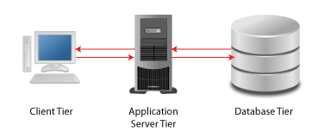
SYSTEM DESIGN
HTML, CSS, JavaScript
Apache Server. PHP
MySQL DB

Slide 12
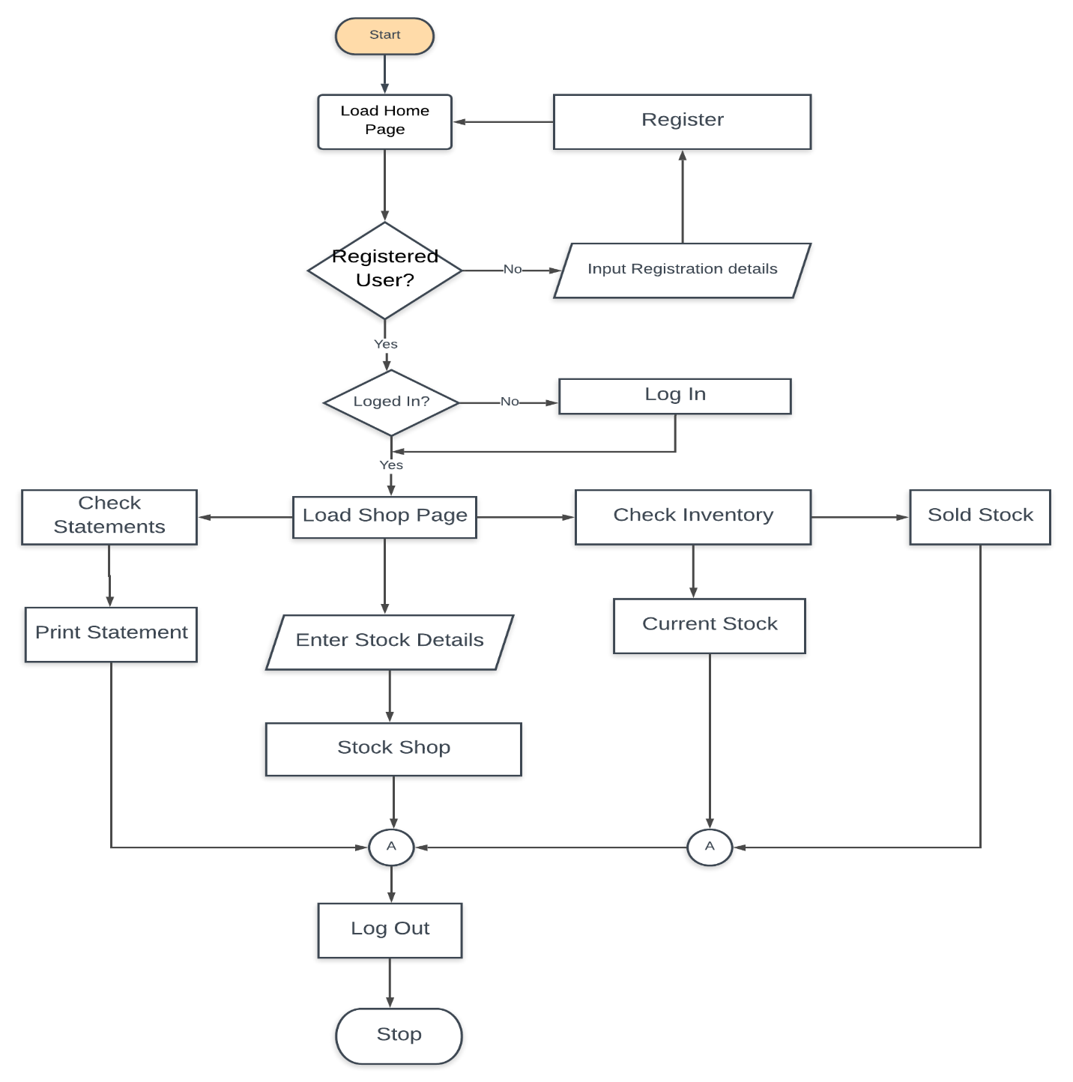
Shop Inventory MIS Flow Chart

Slide 13
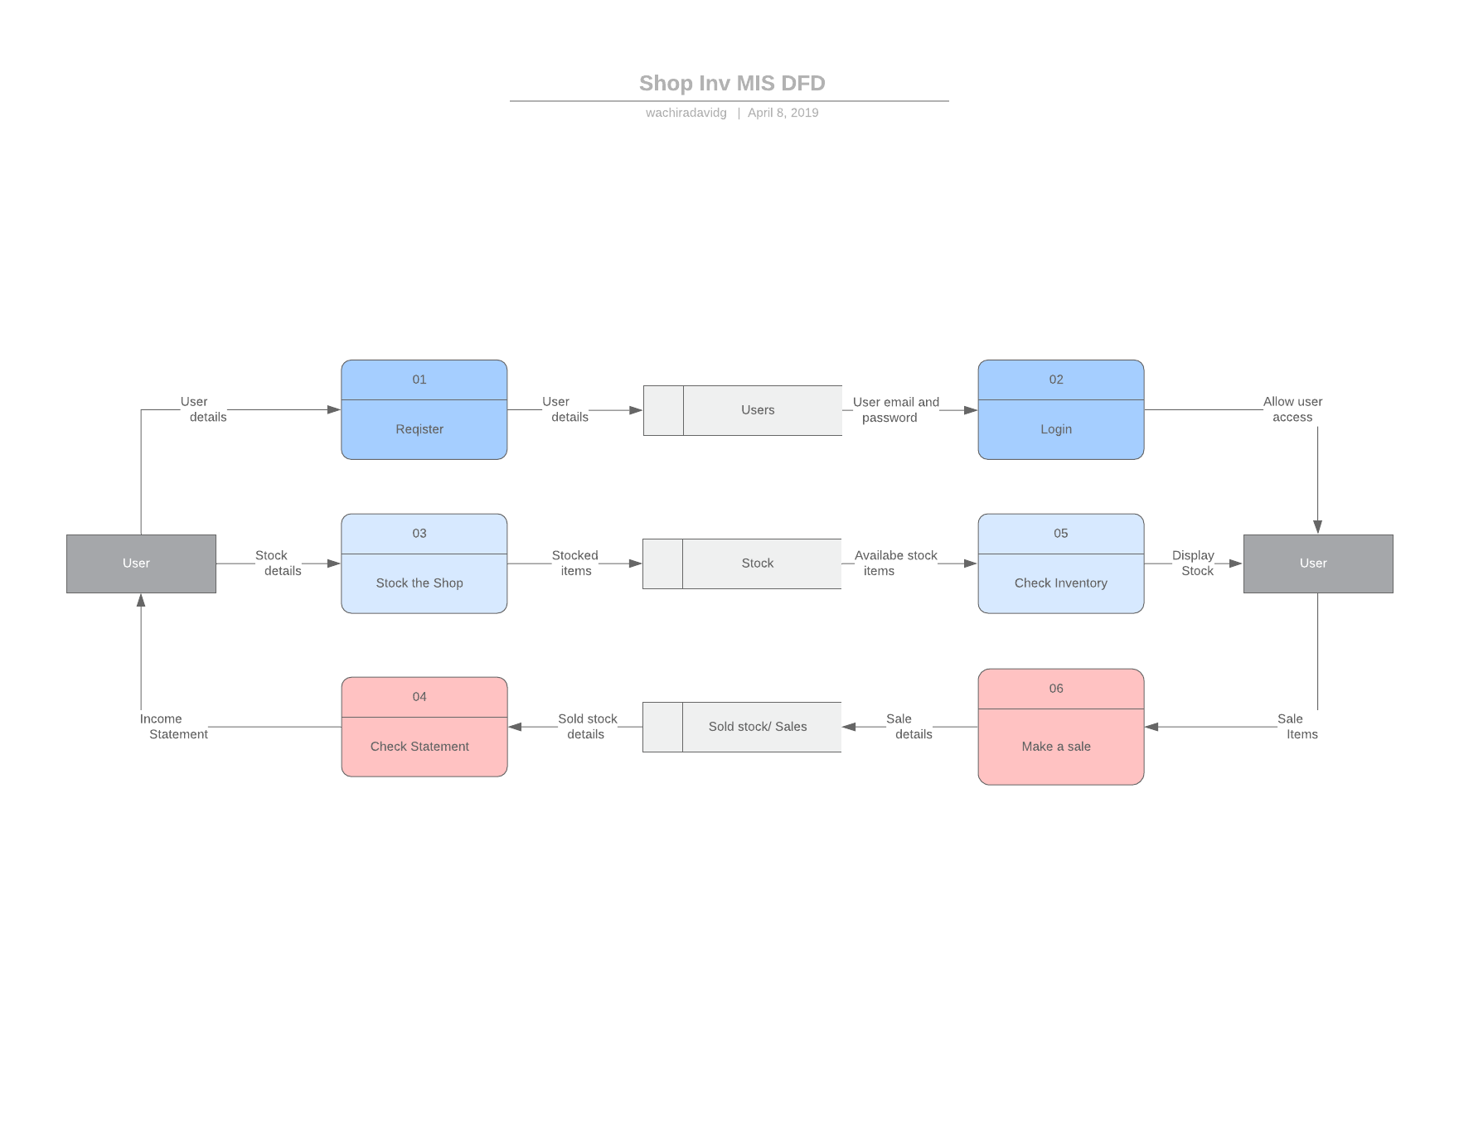
SHOP INVENTORY MIS DFD

Slide 14
CONCLUSION
It is important that shop keepers have a software system for record keeping and inventory tracking.
This system would give the shopkeepers an interface for easy record keeping and analysis of data such as; stock sold, available stock, amount of profit made, amount of loss made, etc.
According to (Experian Information Solution Inc, 2018) “You need good records to monitor the progress of your business. Records can show whether your business is improving, which items are selling, or what changes you need to make. Good records can increase the likelihood of business success.”
The proposed system provides a cheap and simple way for shop keepers and business owners to meet the above objective.
Notes:
Importance of the system.?
Does it solve the problem?
It make tracking of business progress easy and in other cases possible
How, Reports, statements, Inventory/stock report

Slide 15
RECOMMENDATIONS
The following recommendations (when implemented) would make the Shop Inventory MIS an even better system i.e. more efficient and effective in meeting user requirements. They include: -
Development of mobile applications for the system in the various platforms e.g. android, windows etc.
Implementing offline use of the system.
Integration of payment methods, especially Mpesa.
Including Profit and Loss predictions from previous data analysis.

Slide 16
REFERENCES
Picincu, A., 2018. What is Tally Accounting Software. [Online] Available at: https://bizfluent.com/about-7321977-tally-accounting-software-.html [Accessed 30 November 2018].
Sincero, S. M., 2012. Personal Interview Survey. [Online] Available at: https://explorable.com/personal-interview-survey [Accessed 28 November 2018].
S, M., 2011. Software Development Life Cycle Models and Methodologies. [Online] Available at: https://www.google.com/amp/s/melsatar.blog/2012/3/15/software-development-life-cycle-models-and-methodologies/amp/ [Accessed 29 November 2018].
Taylor, F. W., 1919. Shop Management. 1st ed. New York and London: Harper and Brothers Publishers.
Hormozi et al., Manufacturing process improvement: The role of vision systems, Production and Inventory Management Journal. Alexandria: Fourth Quarter 1992, vol. 33,
Tyagi, G., 2000. 6 Stages of Software Development Process. [Online] Available at: www.synaseindia.com/6-stages-of-software-development-process/141 [Accessed 29 November 2018].
Magher, M., 2018. How to Write a Justification. [Online] Available at: www.education.seattle.com/write-justification-narrative-6609.html [Accessed 29 December 2018].
McLeod, S., 2018. Questionnaire. [Online] Available at: htteps://www.simplypsychology.org/questionnaires.html [Accessed 28 November 2018].
Nextar, 2018. Supermarket POS Software. [Online] Available at: www.nextar.com/examples/supermarket [Accessed 29 December 2018].
Owlgen, 2018. Distinguish between different types of small-scale retailers. [Online] Available at: https://www.owlgen.com/question/distinguish-between-different-types-of-small-scale-retailers [Accessed 30 November 2018].

Slide 17
THANK YOU! GOD BLESS!

